Slide 1

SALES AND CUSTOMER BEHAVIOUR ANALYSIS
BY:- Shinoy Babru

Slide 2
ABOUT THE DATA
Dataset Characteristics:
Columns: The dataset contains 17 + 3 columns. This means there are 17 primary columns and an additional 3 columns.
Rows: There are 1000 rows in the dataset, representing individual data entries.
Branches:
The data is sourced from three different branches labelled A, B, and C.
Location:
The dataset pertains to Myanmar cities: Yangon, Mandalay, and Naypyitaw. These locations might be relevant for regional analysis or comparisons.
Information Contained:
The dataset includes various types of information:
Product Line: Details about different product categories or offerings.
Customer Type: Information on customer segments
Timestamp: Time-related data.
Payment Method:

Slide 3
APPROACH USED
Data Wrangling:
Build a database and table.
Insert data.
Handle missing values.
Feature Engineering:
Add new columns (e.g., time of day, weekday, month).
Exploratory Data Analysis (EDA):
Analyze the dataset to uncover insights.
Address 28 specific questions.

Slide 4
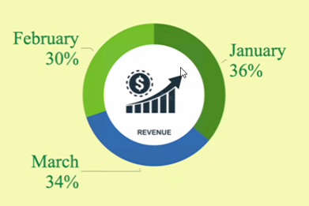
SALES ANALYSIS
Revenue and Sales:
Naypyitaw (Branch C) has the highest revenue and sales.
Best-performing months (in terms of revenue and cost of goods sold) are January, followed by March, and then February.
Sales Timing:
Most sales occur on Mondays.
Afternoons see the highest activity.
Low Activity:
Lowest activity is recorded in the morning.

Slide 5
CUSTOMER ANALYSIS
Total Members: There are 501 members in total.
Total Normal: There are 499 normal members in total
Gender Distribution:
a. Total Members b. Total Normal
Females: 261 1. Female : 240
Males: 240 2. Males : 259
City-wise Gender Distribution:
Yangon: Females - 161, Males - 179
Mandalay: Females - 162, Males - 170
Naypyitaw: Females - 178, Males - 150
Highest Sales by Gender in Product Categories:
Food and beverages: Female
Fashion accessories: Female
Sports and travel: Female
Electronic accessories: Male
Health and beauty: Male
Home and lifestyle: Male

Slide 6
SUMMARY
High Potential in Foods & Beverages:
Target the female category to further increase sales.
Boost Health & Beauty Segment:
Also target females to enhance sales in this category.
Strategic Timing for Ads:
Morning: Home & Lifestyle
Afternoon: Sports & Travel
Evening: Food & Beverages
User Engagements in February:
Increase ads and offer discounts during this month.
City-Specific Campaigns:
Focus on cities and their corresponding gender majority for successful campaigns.

